Slide 1

St Paul’s Church in Wales Primary School
Secondary School Applications

Slide 2
Key Dates
Deadline: Monday 18th November 2024
Offers Day: Monday 3rd March 2025
Any appeals take place after this date.

Slide 3

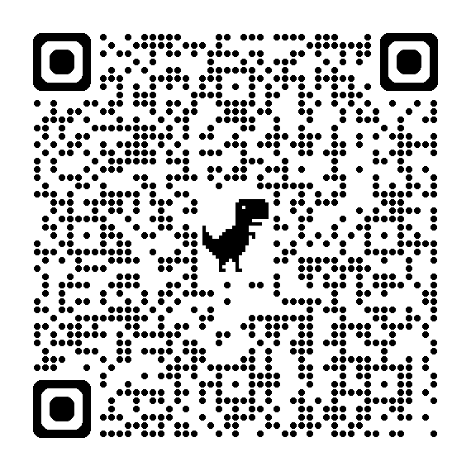
Key Document

Slide 4
How to Apply
Different schools have different processes.
MOST need you to apply in the Cardiff Portal
You need an email address to do this
You can apply to up to 5 schools through this portal.

Slide 5
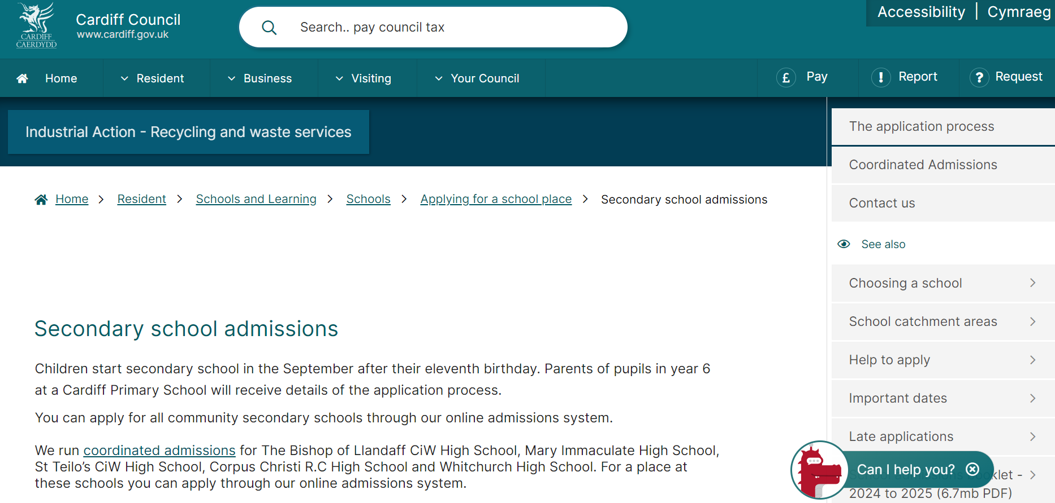
Cardiff Portal

Slide 6
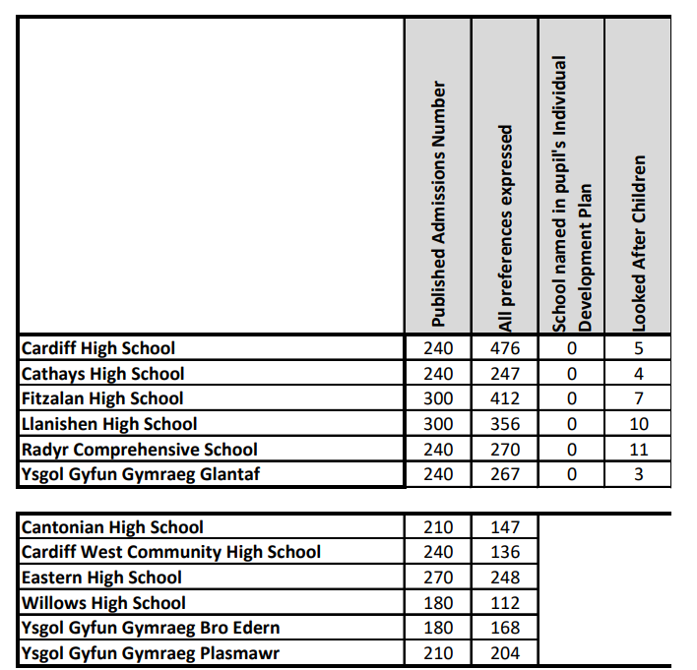

Slide 7

Fitzalan High School
Like all of the Cardiff Schools this needs to be completed through the CARDIFF PORTAL
Location is key for this school to your home address.
There are no catchment schools so this is the closest but it is not guaranteed that you will get a place.
412 applied for 300 places in the last academic year.
Siblings in year 7-11 count as siblings this year.

Slide 8
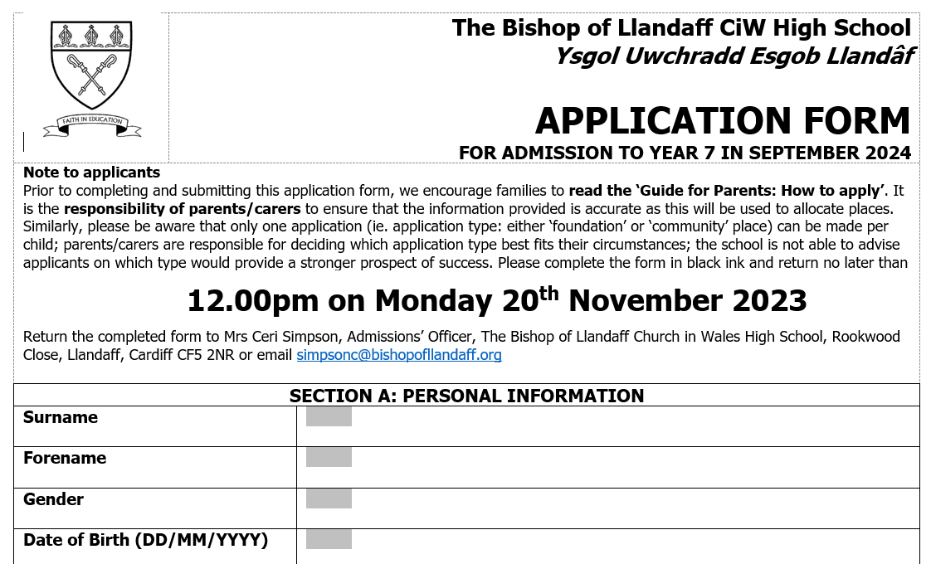
Bishop of Llandaff
Paper form and the Council Admission Portal
Open Places for non Christian and Non Church Going pupils.
Foundation places for regular church attendance! They check!

Slide 9

St Teilos
Paper and Online Form.
Online form will open on Wednesday 16th October at 9am.
Choose foundation place and indicate that your child attends this school in order to gain a place.
160 foundation places
80 Open places

Slide 10

St Cyres
Online through VALE OF GLAMORGAN
Same deadlines
Doesn’t count as a Cardiff application. They will chase you if you only apply here.
Very limited places
10 appeals – 10 unsuccessful

Slide 11
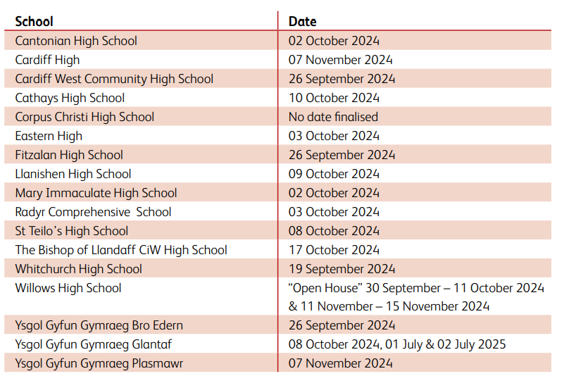
Open Evenings

Slide 12
St Paul’s Church in Wales Primary School
Any Questions?

